Slide 1
Process to Process (TCP and UDP)

Slide 2
PROCESS-TO-PROCESS DELIVERY
The transport layer is responsible for process-to-process delivery—the delivery of a packet, part of a message, from one process to another. Two processes communicate in a client/server relationship, as we will see later.
Topics discussed in this section:
Client/Server Paradigm
Multiplexing and Demultiplexing
Connectionless Versus Connection-Oriented Service
Reliable Versus Unreliable
Three Protocols

Slide 3

Note
The transport layer is responsible for process-to-process delivery.

Slide 4
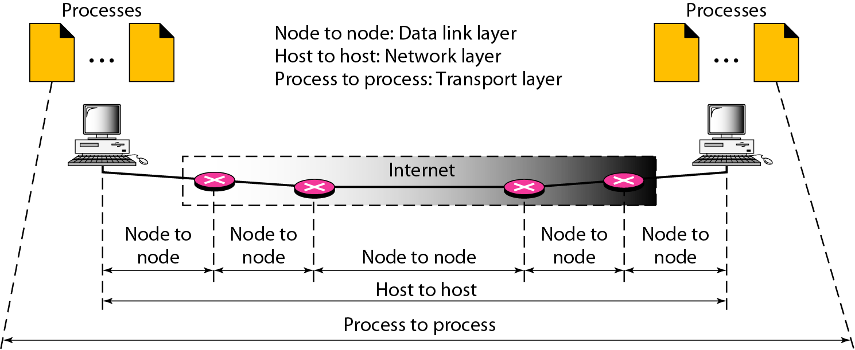
Types of data deliveries

Slide 5
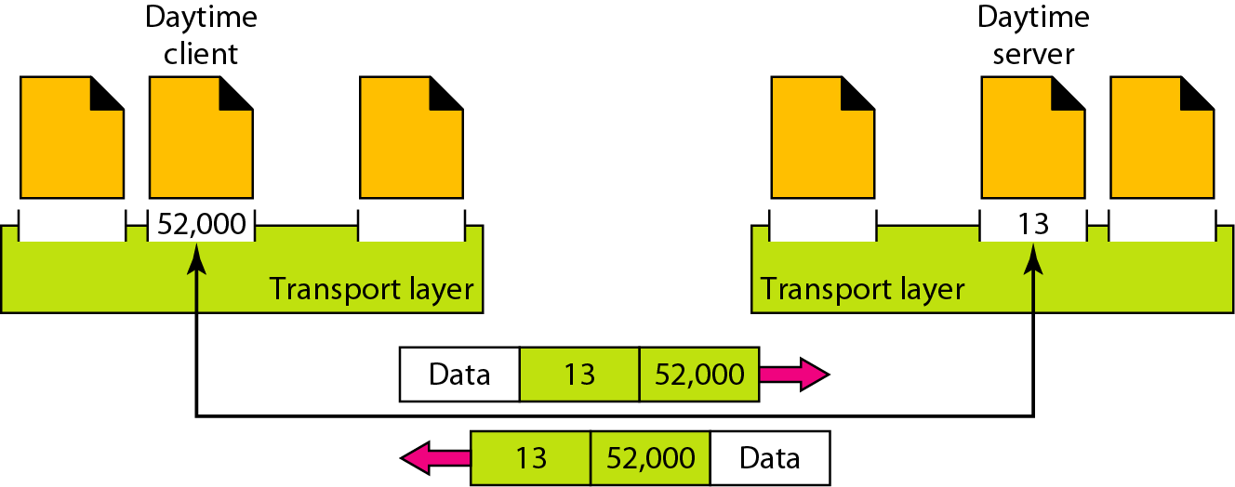
Port numbers

Slide 6
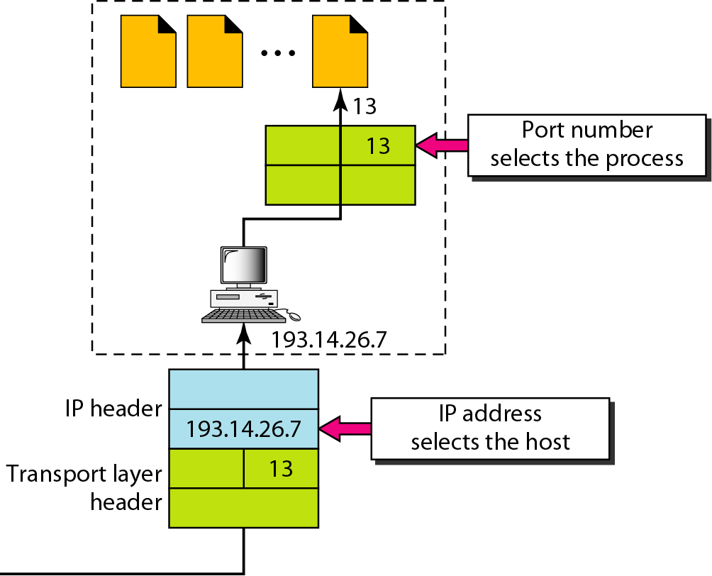
IP addresses versus port numbers

Slide 7
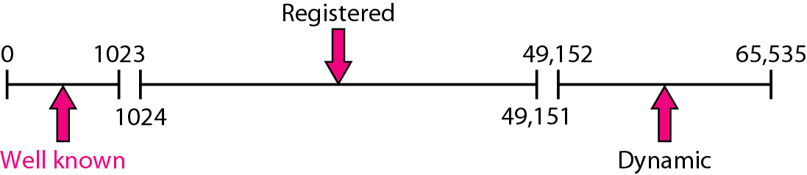
IANA ranges

Slide 8
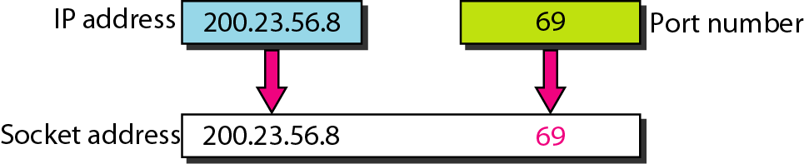
Socket address

Slide 9
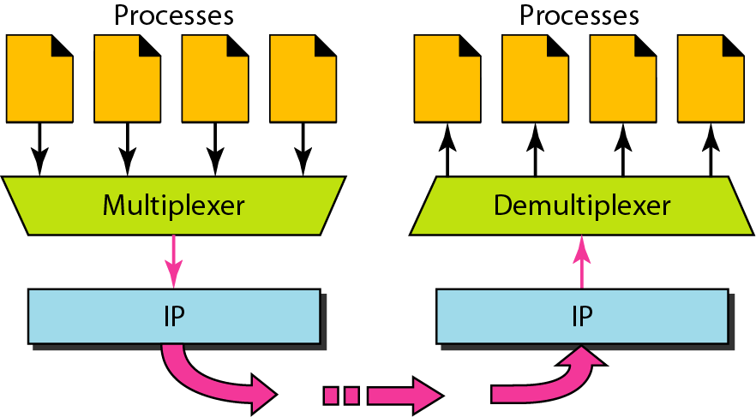
Multiplexing and demultiplexing

Slide 10
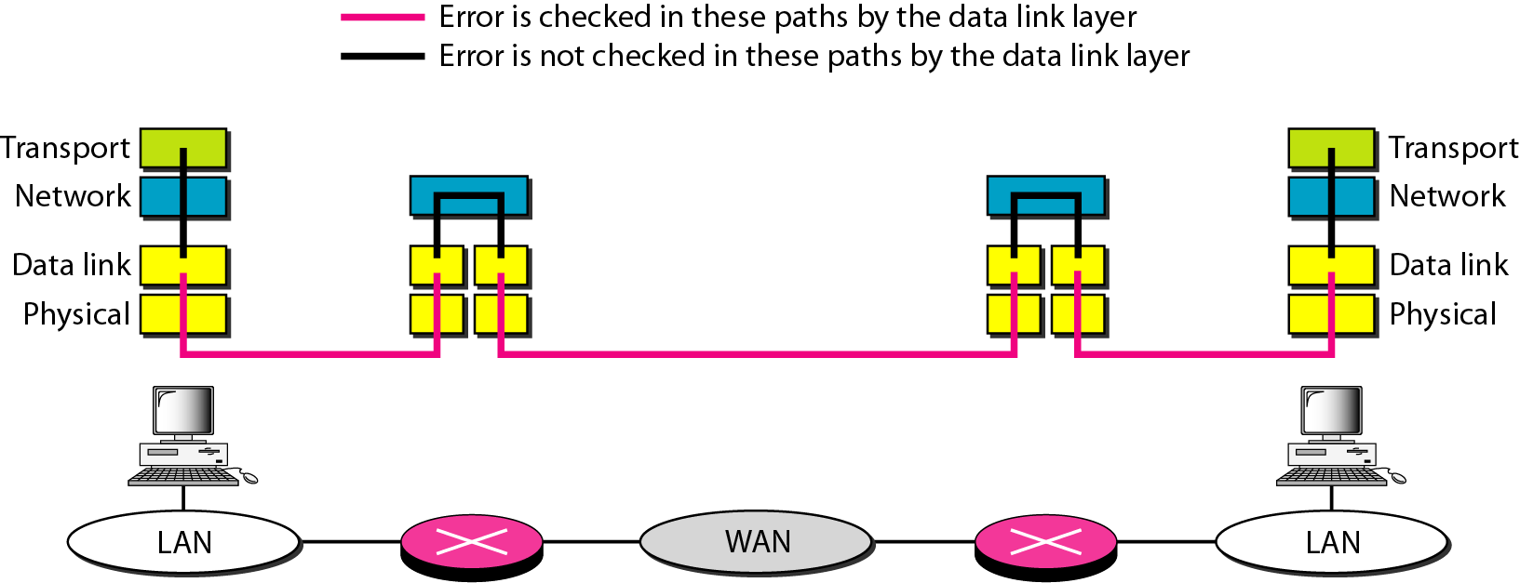
Error control

Slide 11
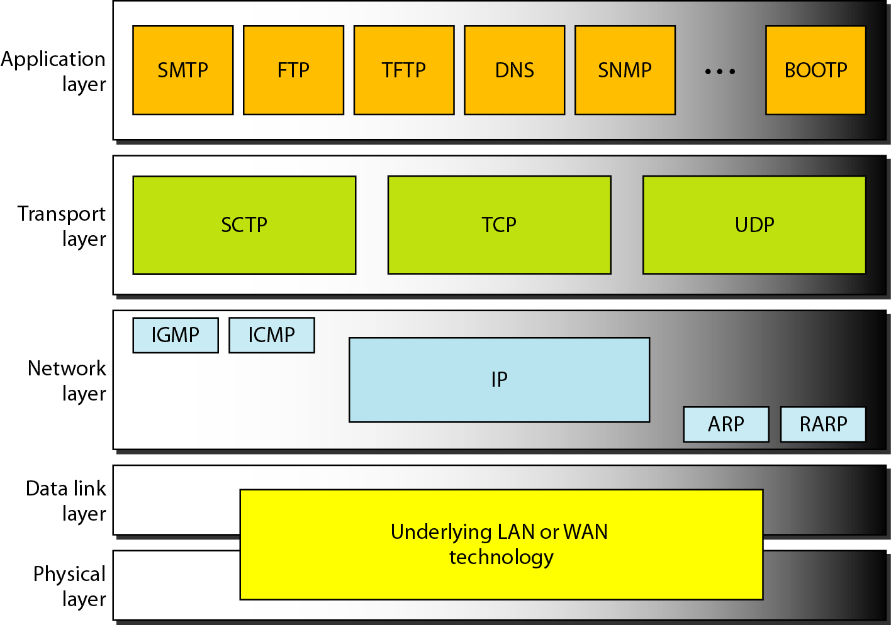
Position of UDP, TCP, and SCTP in TCP/IP suite

Slide 12
USER DATAGRAM PROTOCOL (UDP)
The User Datagram Protocol (UDP) is called a connectionless, unreliable transport protocol. It does not add anything to the services of IP except to provide process-to-process communication instead of host-to-host communication.
Topics discussed in this section:
Well-Known Ports for UDP
User Datagram
Checksum
UDP Operation
Use of UDP

Slide 13
Well-known ports used with UDP

Slide 14
Example
In UNIX, the well-known ports are stored in a file called /etc/services. Each line in this file gives the name of the server and the well-known port number. We can use the
grep utility to extract the line corresponding to the desired application. The following shows the port for FTP. Note that FTP can use port 21 with either UDP or TCP.

Slide 15
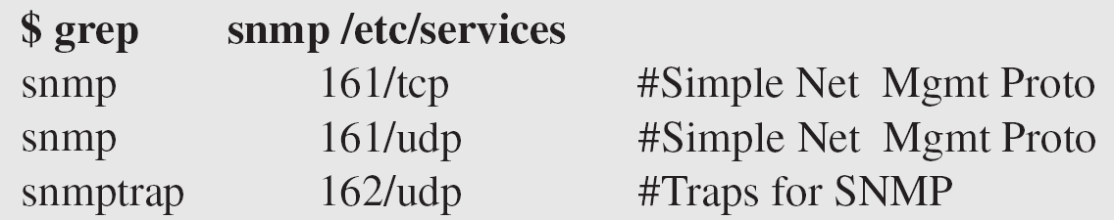
Example (continued)
SNMP uses two port numbers (161 and 162), each for a different purpose, as we will see in Chapter 28.

Slide 16
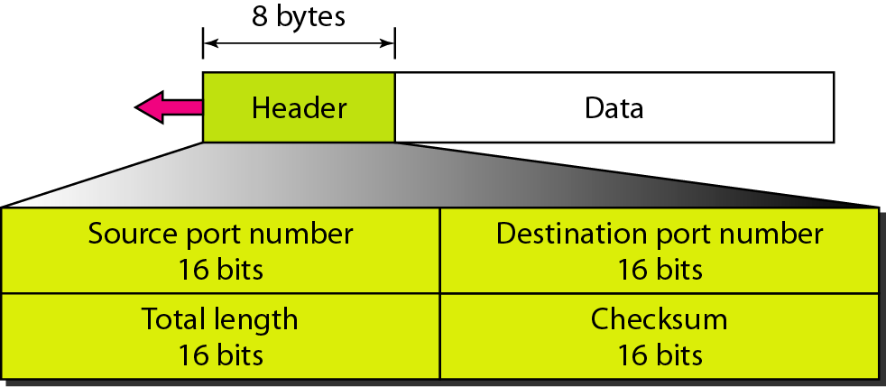
User datagram format

Slide 17
Note
UDP length
= IP length – IP header’s length

Slide 18
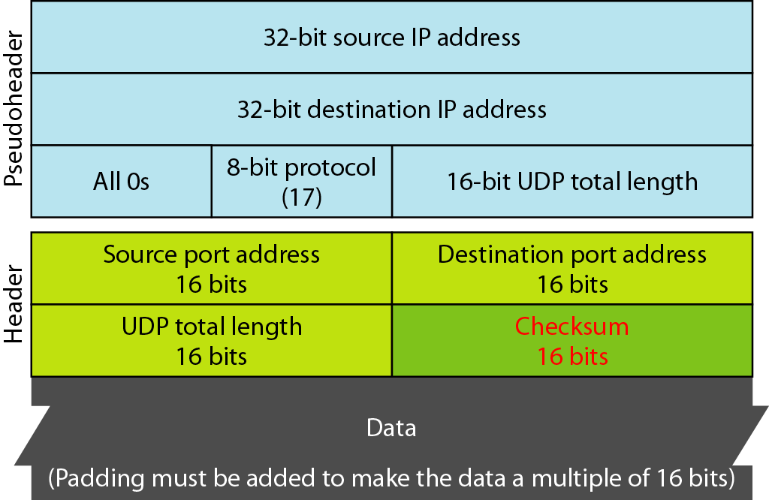
Pseudoheader for checksum calculation

Slide 19
Example
Figure 23.11 shows the checksum calculation for a very small user datagram with only 7 bytes of data. Because the number of bytes of data is odd, padding is added for checksum calculation. The pseudoheader as well as the padding will be dropped when the user datagram is delivered to IP.

Slide 20
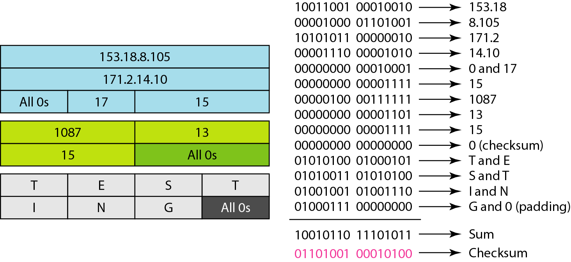
Checksum calculation of a simple UDP user datagram

Slide 21
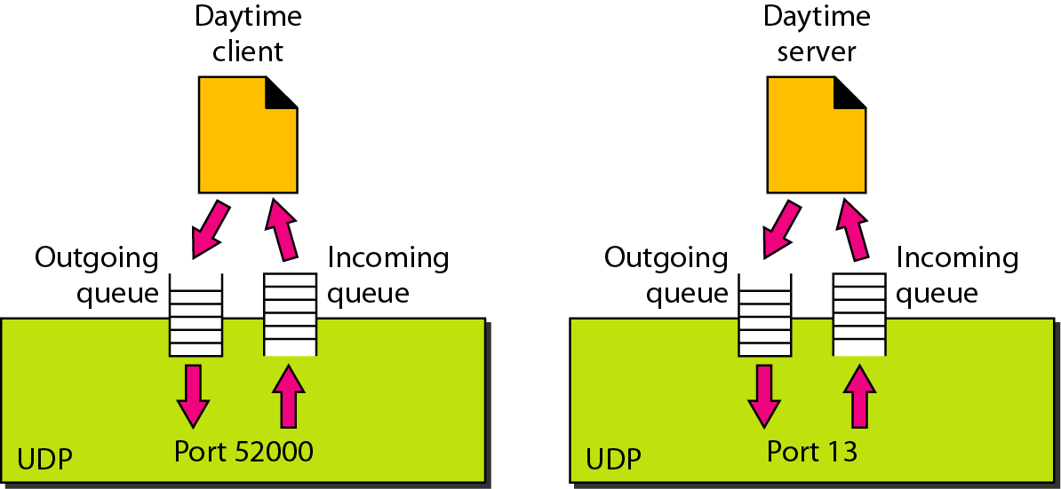
Queues in UDP

Slide 22
TCP
TCP is a connection-oriented protocol; it creates a virtual connection between two TCPs to send data. In addition, TCP uses flow and error control mechanisms at the transport level.
Topics discussed in this section:
TCP Services
TCP Features
Segment
A TCP Connection
Flow Control
Error Control

Slide 23
Well-known ports used by TCP

Slide 24
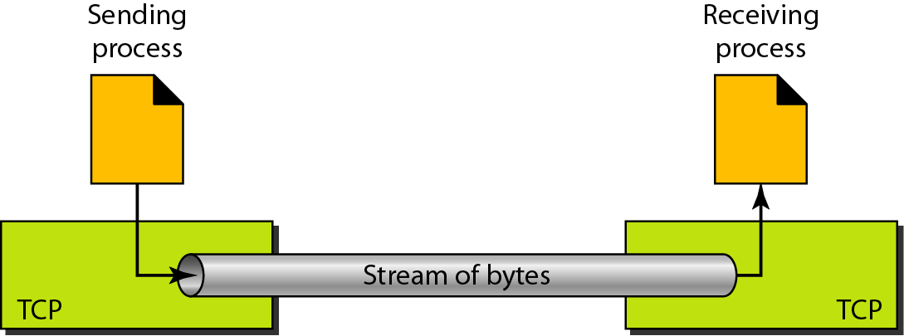
Stream delivery

Slide 25
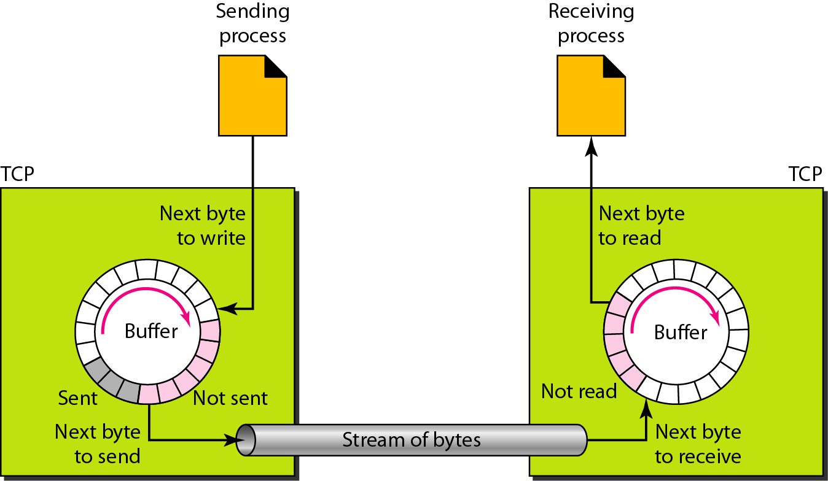
Sending and receiving buffers

Slide 26
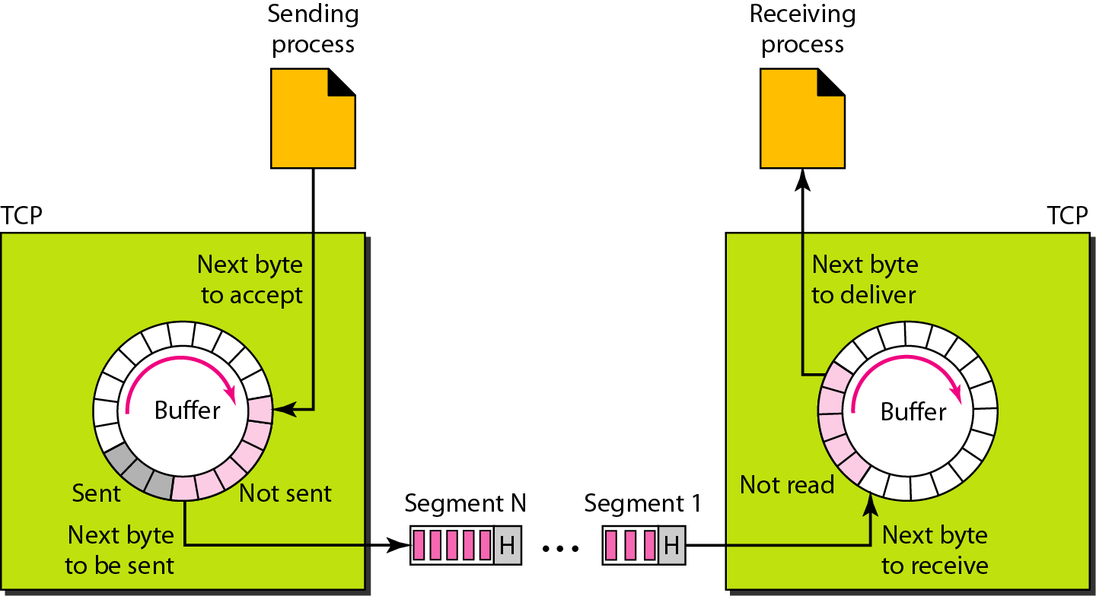
TCP segments

Slide 27
Note
The bytes of data being transferred in each connection are numbered by TCP.
The numbering starts with a randomly generated number.

Slide 28
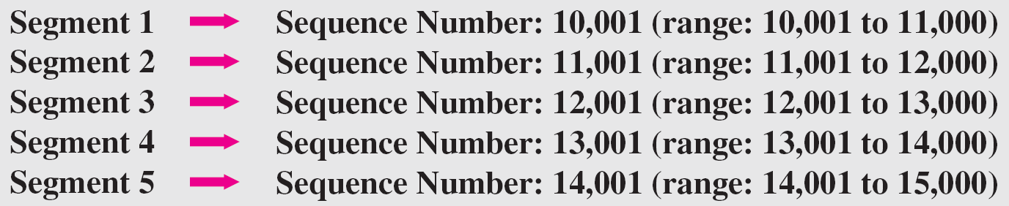
Example
The following shows the sequence number for each segment:

Slide 29
Note
The value in the sequence number field of a segment defines the
number of the first data byte
contained in that segment.

Slide 30
Note
The value of the acknowledgment field in a segment defines
the number of the next byte a party expects to receive.
The acknowledgment number is cumulative.

Slide 31
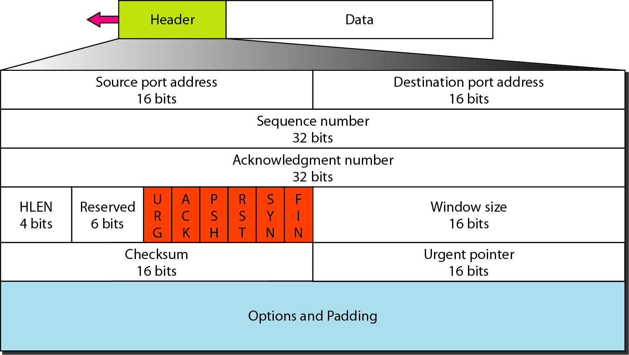
TCP segment format

Slide 32
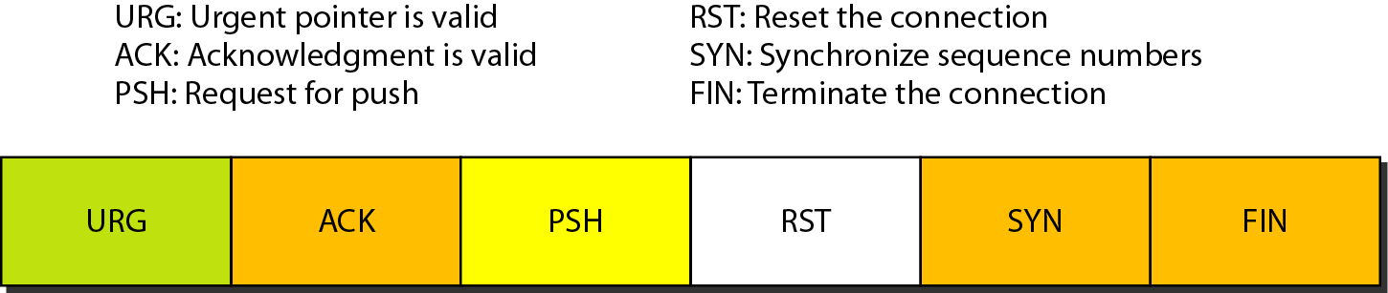
Control field

Slide 33
Description of flags in the control field

Slide 34
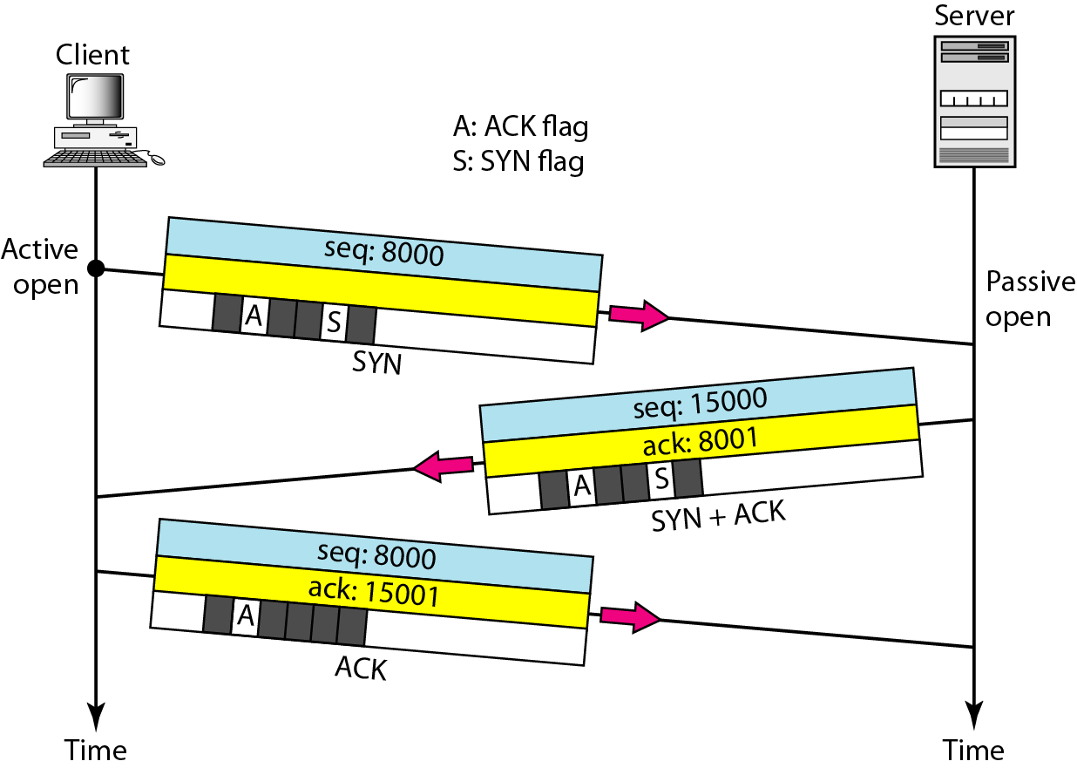
Connection establishment using three-way handshaking

Slide 35
Note
A SYN segment cannot carry data, but it consumes one sequence number.

Slide 36
Note
A SYN + ACK segment cannot
carry data, but does consume one
sequence number.

Slide 37
Note
An ACK segment, if carrying no data, consumes no sequence number.

Slide 38
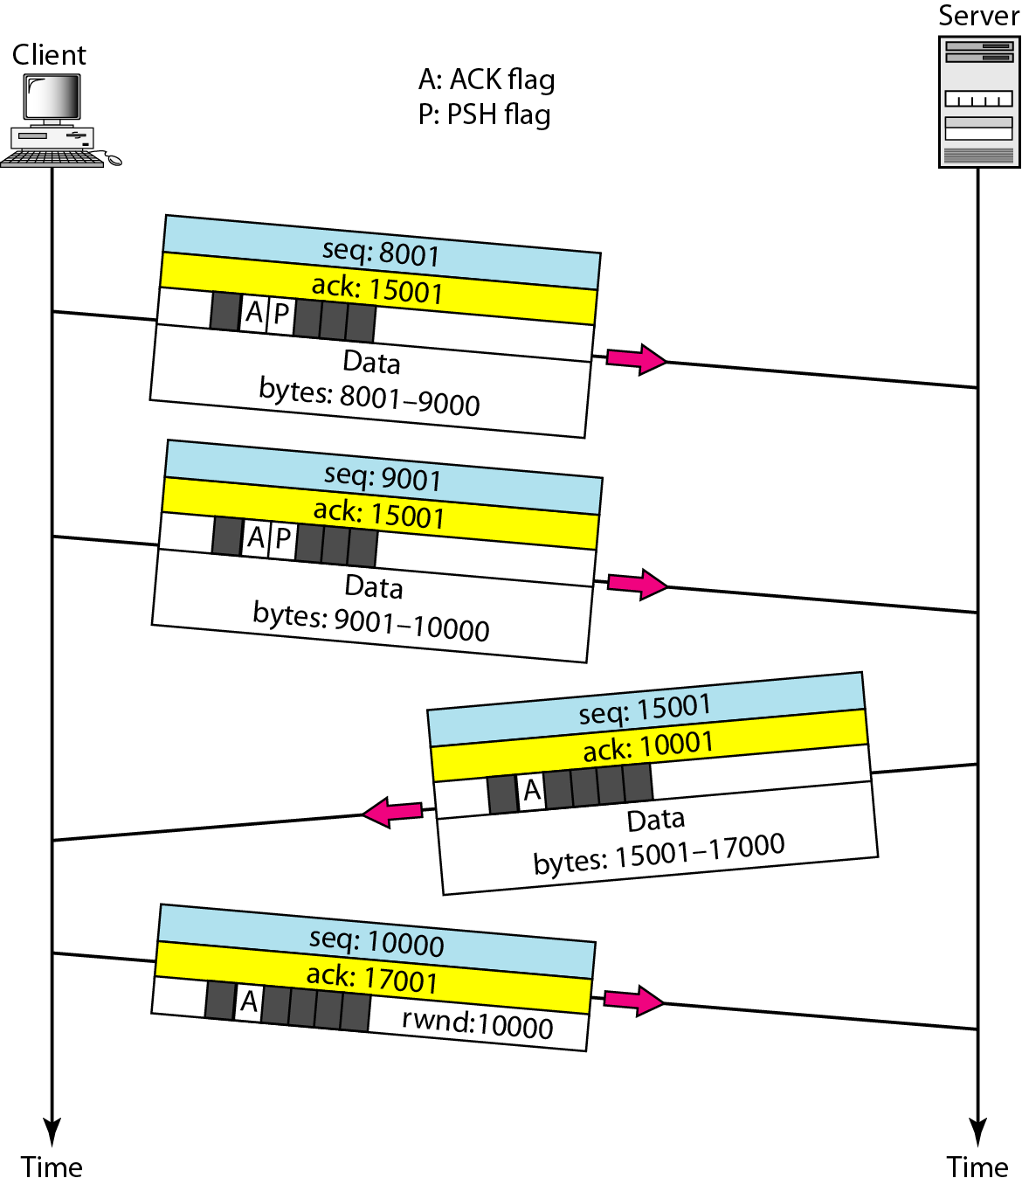
Data transfer

Slide 39
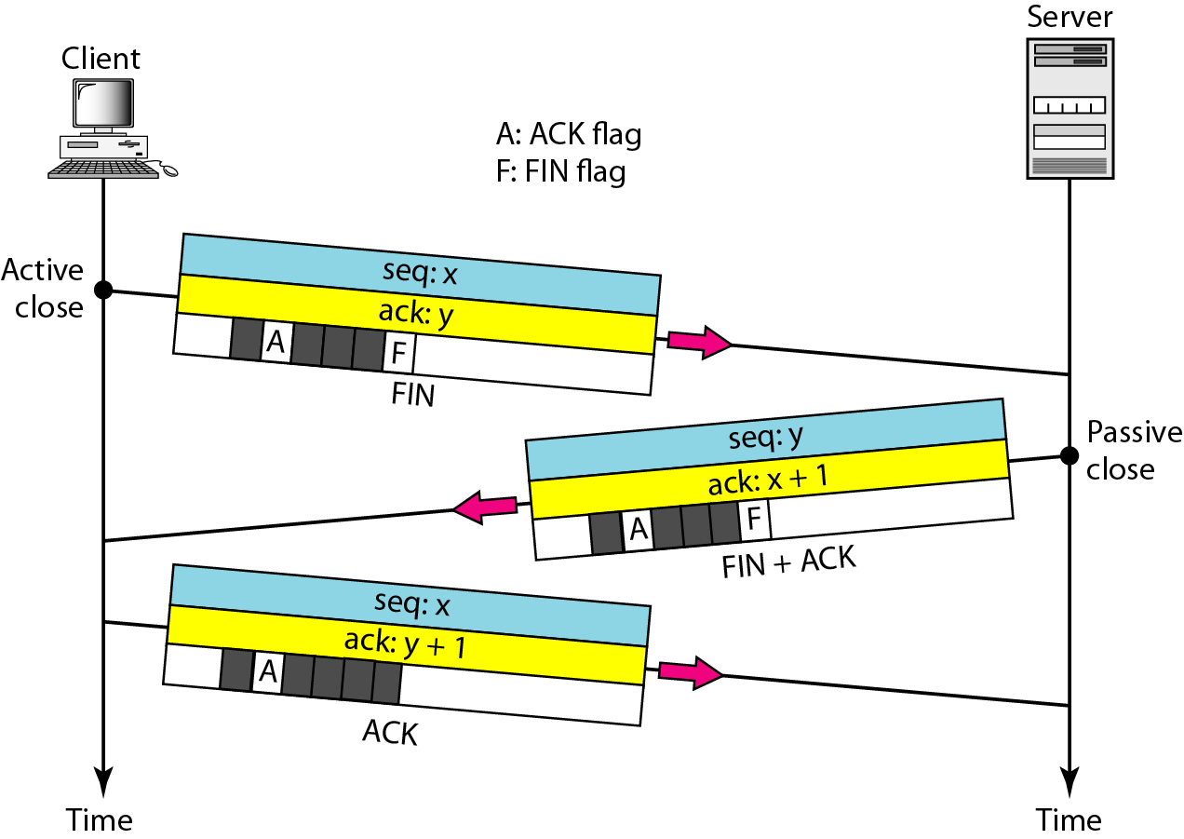
Connection termination using three-way handshaking

Slide 40
Note
The FIN segment consumes one sequence number if it does
not carry data.

Slide 41
Note
The FIN + ACK segment consumes
one sequence number if it
does not carry data.

Slide 42
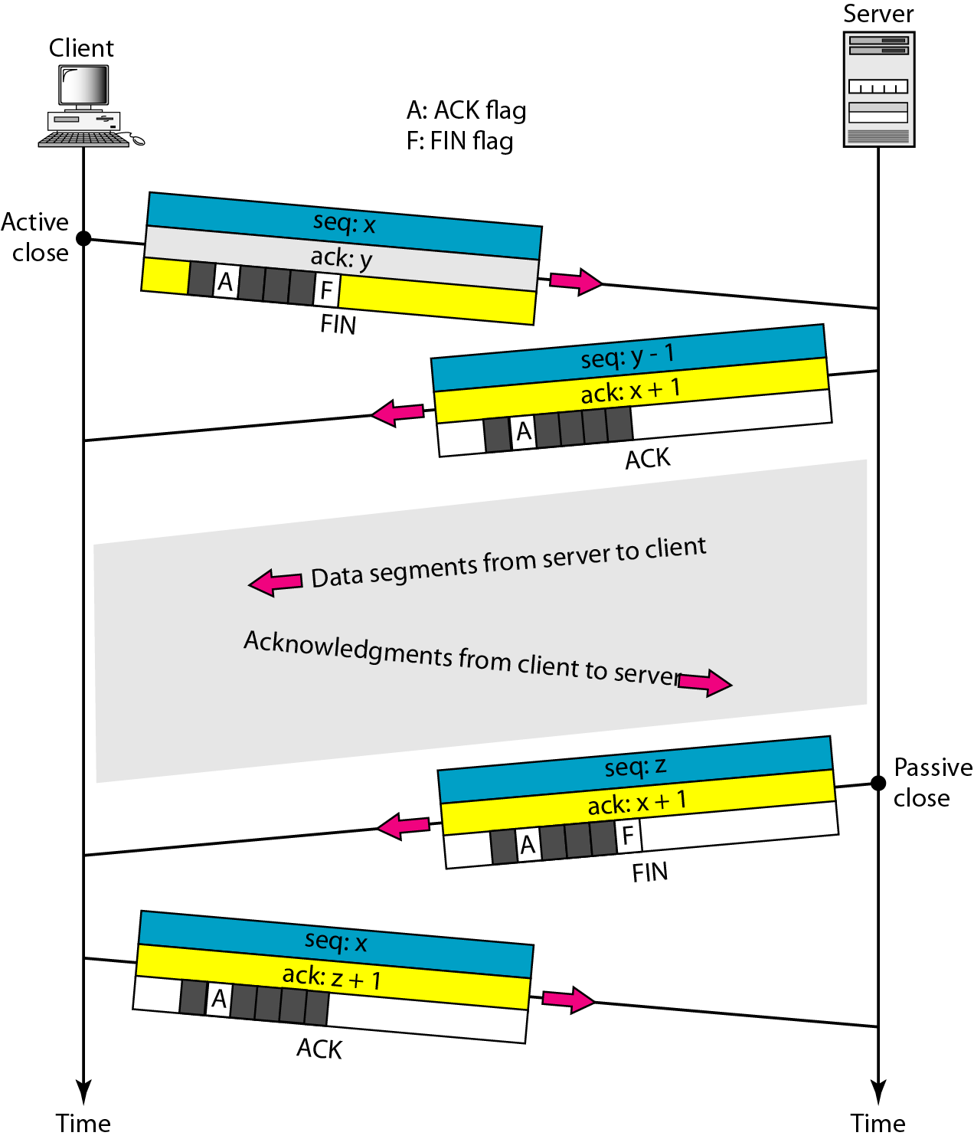
Half-close

Slide 43
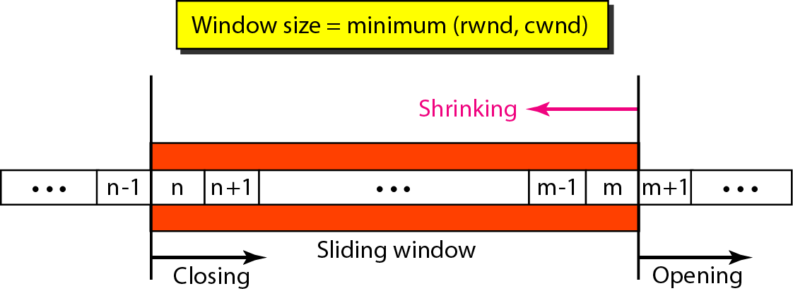
Sliding window

Slide 44
Note
A sliding window is used to make transmission more efficient as well as
to control the flow of data so that the destination does not become
overwhelmed with data.
TCP sliding windows are byte-oriented.

Slide 45
Example
What is the value of the receiver window (rwnd) for host A if the receiver, host B, has a buffer size of 5000 bytes and 1000 bytes of received and unprocessed data?
Solution
The value of rwnd = 5000 − 1000 = 4000. Host B can receive only 4000 bytes of data before overflowing its buffer. Host B advertises this value in its next segment to A.

Slide 46
Example
What is the size of the window for host A if the value of rwnd is 3000 bytes and the value of cwnd is 3500 bytes?
Solution
The size of the window is the smaller of rwnd and cwnd, which is 3000 bytes.

Slide 47
Example
Figure 23.23 shows an unrealistic example of a sliding window. The sender has sent bytes up to 202. We assume that cwnd is 20 (in reality this value is thousands of bytes). The receiver has sent an acknowledgment number of 200 with an rwnd of 9 bytes (in reality this value is thousands of bytes). The size of the sender window is the minimum of rwnd and cwnd, or 9 bytes. Bytes 200 to 202 are sent, but not acknowledged. Bytes 203 to 208 can be sent without worrying about acknowledgment. Bytes 209 and above cannot be sent.

Slide 48
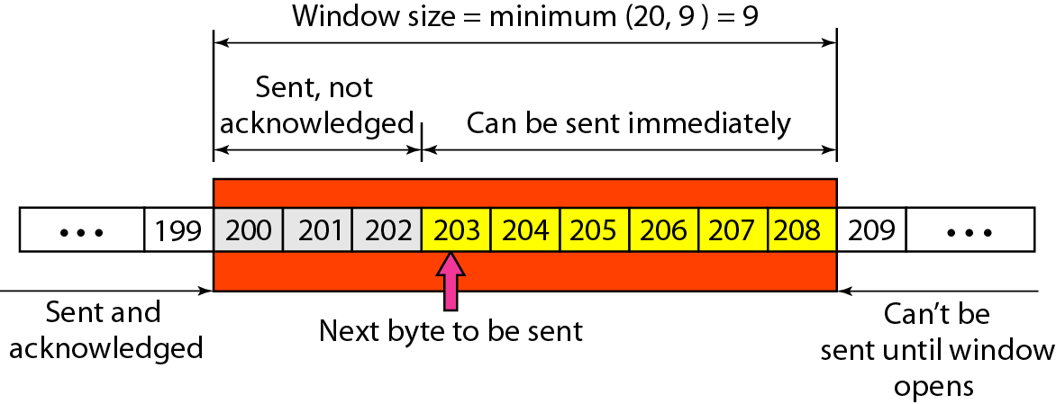
Example

Slide 49
Note
Some points about TCP sliding windows:
❏ The size of the window is the lesser of rwnd and
cwnd.
❏ The source does not have to send a full window’s
worth of data.
❏ The window can be opened or closed by the
receiver, but should not be shrunk.
❏ The destination can send an acknowledgment at
any time as long as it does not result in a shrinking
window.
❏ The receiver can temporarily shut down the
window; the sender, however, can always send a
segment of 1 byte after the window is shut down.

Slide 50
Note
ACK segments do not consume sequence numbers and are not acknowledged.

Slide 51
Note
In modern implementations, a retransmission occurs if the retransmission timer expires or three duplicate ACK segments have arrived.

Slide 52
Note
No retransmission timer is set for an ACK segment.

Slide 53
Note
Data may arrive out of order and be temporarily stored by the receiving TCP,
but TCP guarantees that no out-of-order segment is delivered to the process.

Slide 54
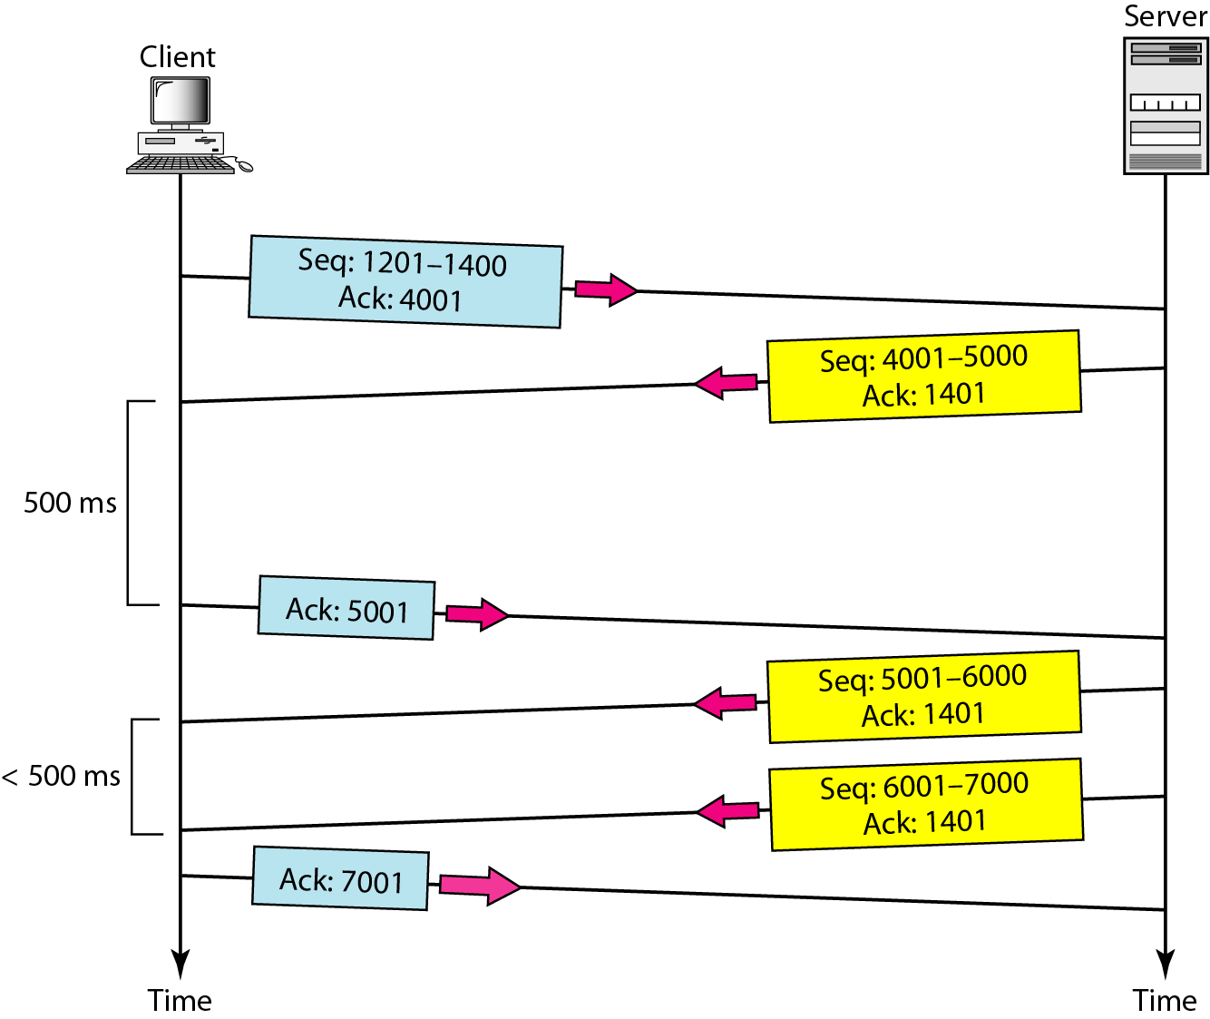
Normal operation

Slide 55
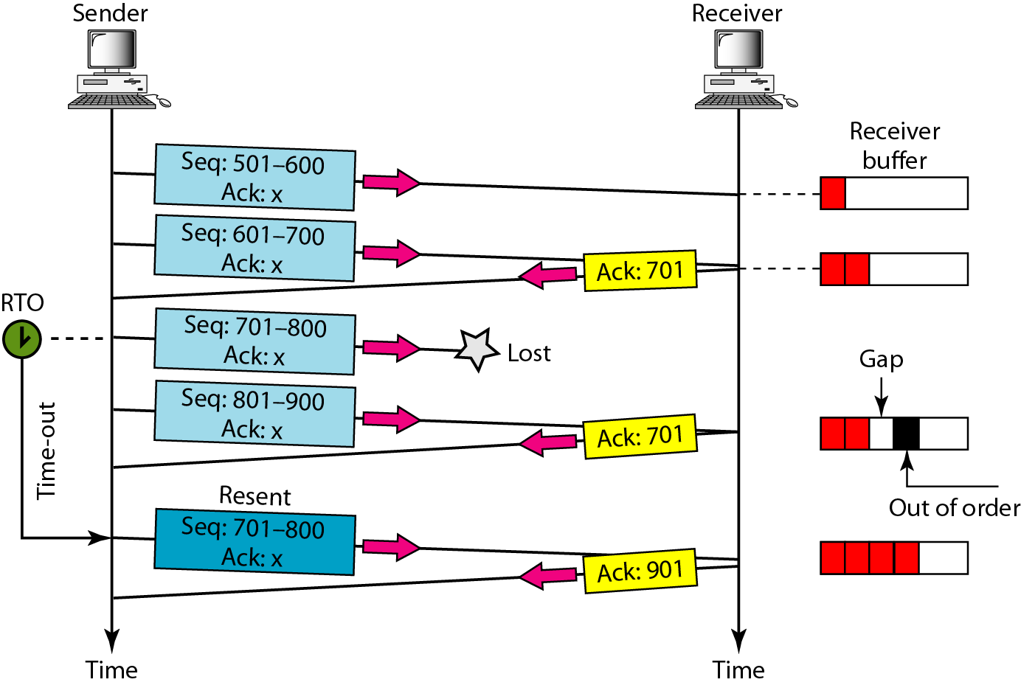
Lost segment

Slide 56
Note
The receiver TCP delivers only ordered data to the process.

Slide 57
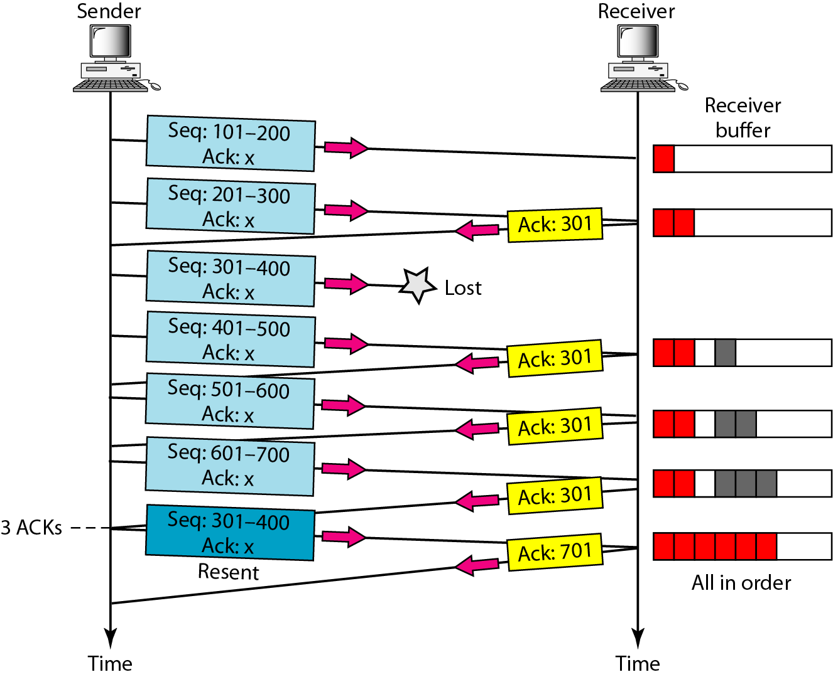
Fast retransmission

Slide 58
SCTP
Stream Control Transmission Protocol (SCTP) is a new reliable, message-oriented transport layer protocol. SCTP, however, is mostly designed for Internet applications that have recently been introduced. These new applications need a more sophisticated service than TCP can provide.
Topics discussed in this section:
SCTP Services and Features
Packet Format
An SCTP Association
Flow Control and Error Control

Slide 59
Note
SCTP is a message-oriented, reliable protocol that combines the best features of UDP and TCP.

Slide 60
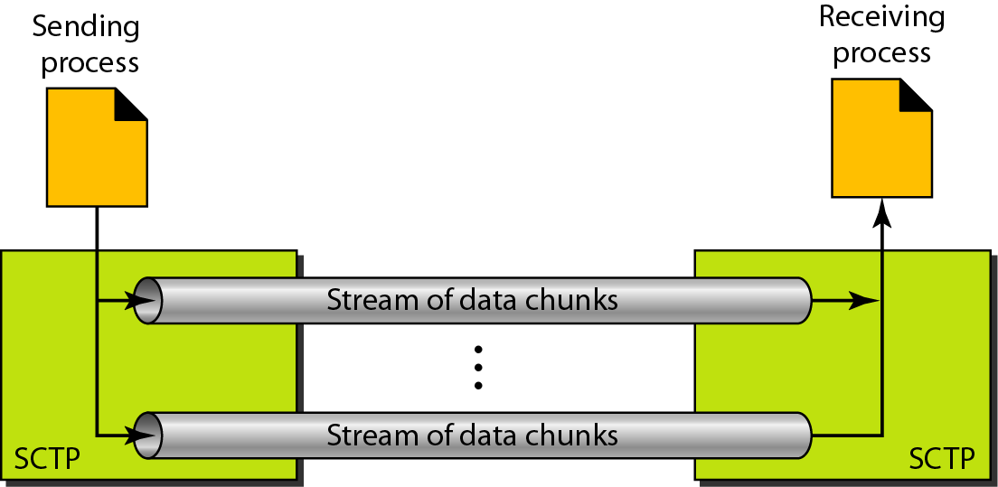
Multiple-stream concept

Slide 61
Note
An association in SCTP can involve multiple streams.

Slide 62
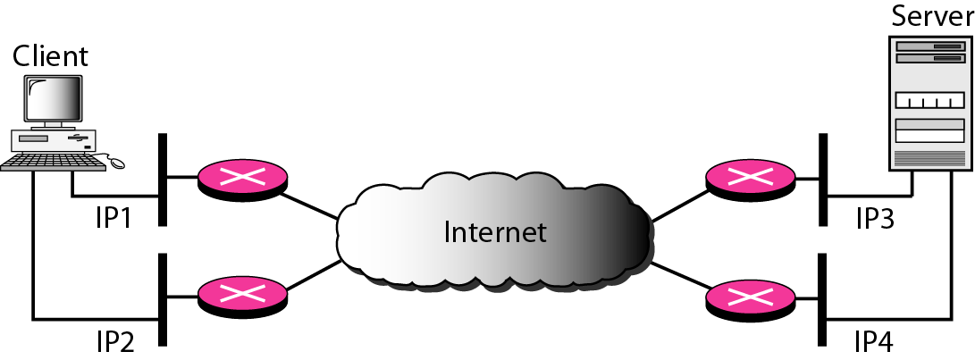
Multihoming concept

Slide 63
Note
SCTP association allows multiple IP addresses for each end.

Slide 64
Note
In SCTP, a data chunk is numbered using a TSN.

Slide 65
Note
To distinguish between different streams, SCTP uses an SI.

Slide 66
Note
To distinguish between different data chunks belonging to the same stream, SCTP uses SSNs.

Slide 67
Note
TCP has segments; SCTP has packets.

Slide 68
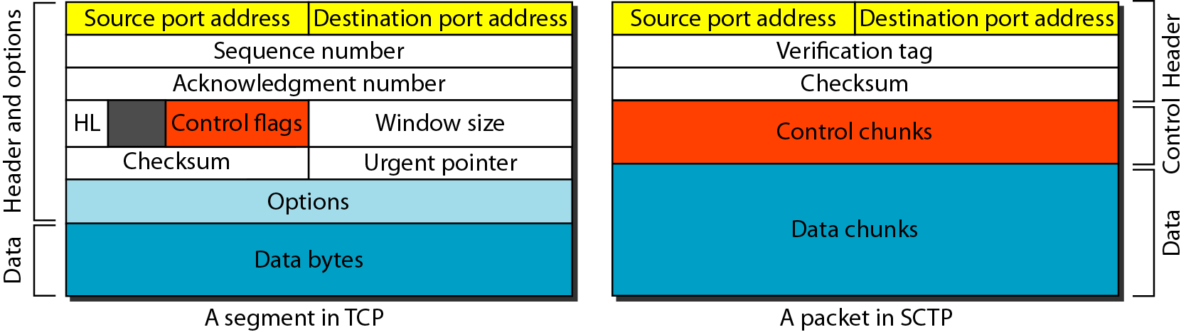
Comparison between a TCP segment and an SCTP packet

Slide 69
Note
In SCTP, control information and data information are carried in separate chunks.

Slide 70
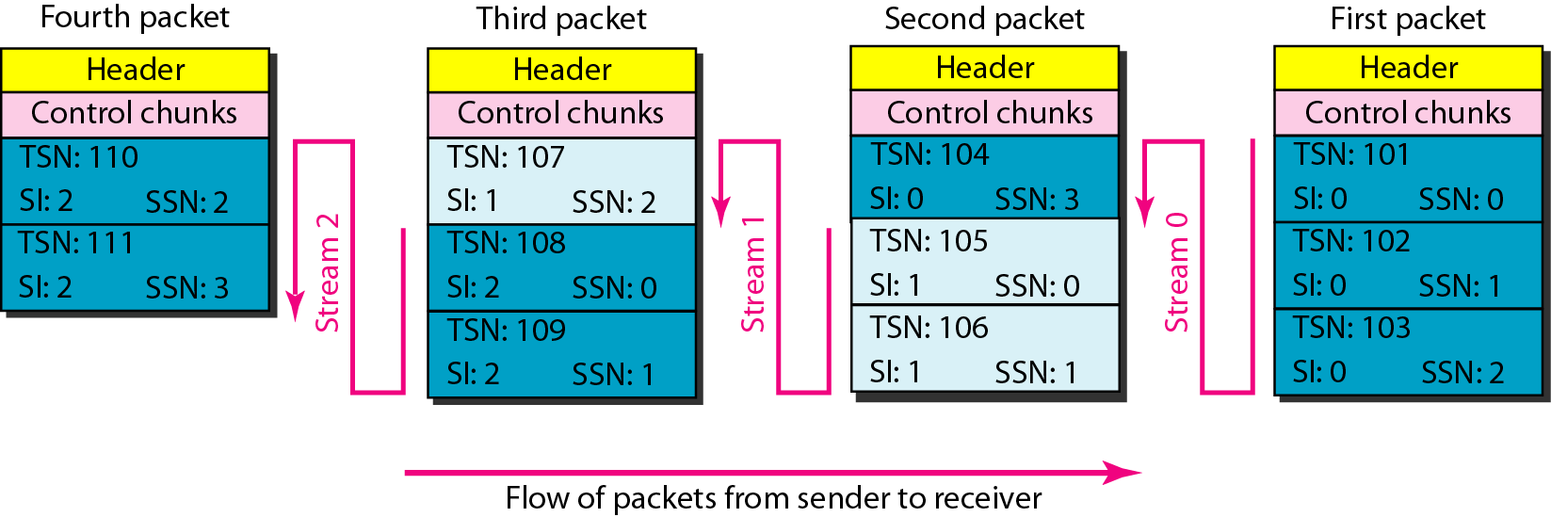
Packet, data chunks, and streams

Slide 71
Note
Data chunks are identified by three items: TSN, SI, and SSN.
TSN is a cumulative number identifying the association; SI defines the stream; SSN defines the chunk in a stream.

Slide 72
Note
In SCTP, acknowledgment numbers are used to acknowledge only data chunks;
control chunks are acknowledged by other control chunks if necessary.

Slide 73
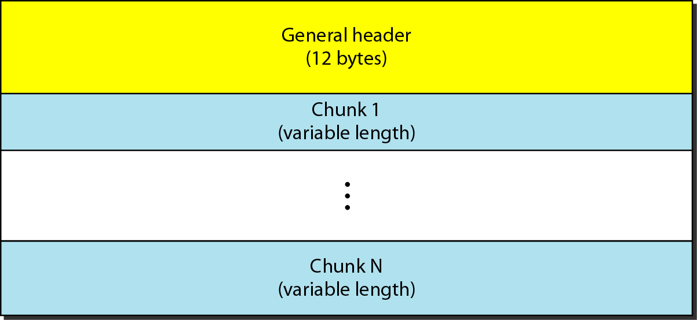
SCTP packet format

Slide 74
Note
In an SCTP packet, control chunks come before data chunks.

Slide 75
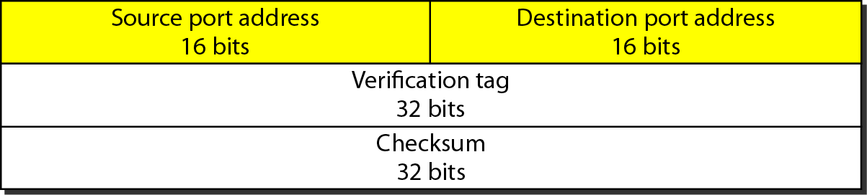
General header

Slide 76
Chunks

Slide 77
Note
A connection in SCTP is called an association.

Slide 78
Note
No other chunk is allowed in a packet carrying an INIT or INIT ACK chunk.
A COOKIE ECHO or a COOKIE ACK chunk can carry data chunks.

Slide 79
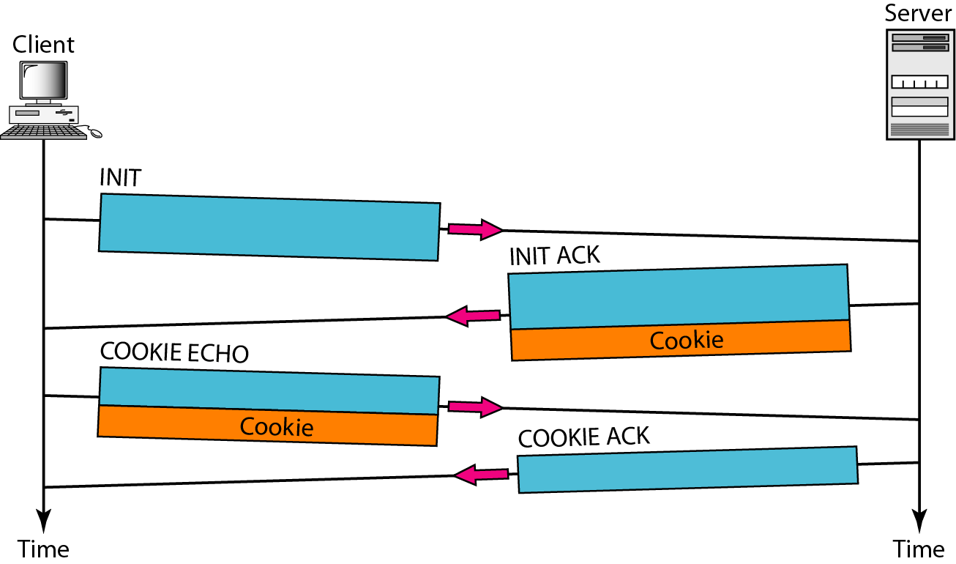
Four-way handshaking

Slide 80
Note
In SCTP, only DATA chunks
consume TSNs;
DATA chunks are the only chunks
that are acknowledged.

Slide 81
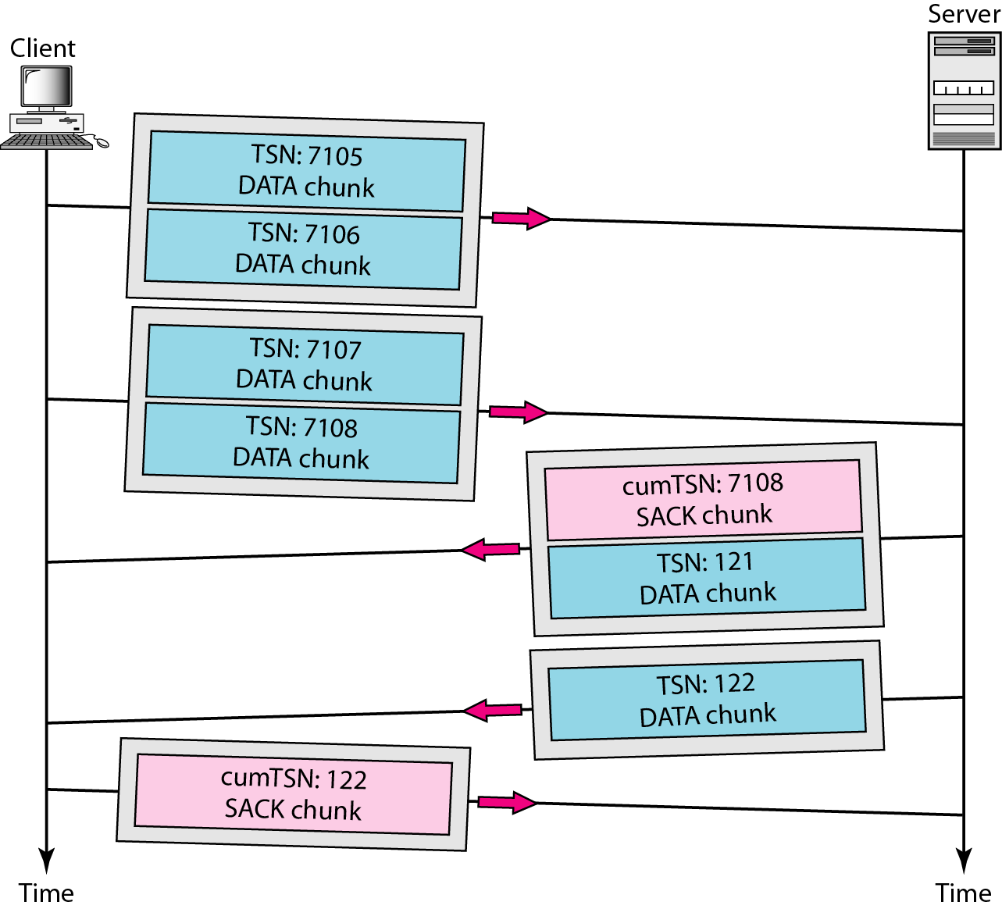
Simple data transfer

Slide 82
Note
The acknowledgment in SCTP defines the cumulative TSN, the TSN of the last data chunk received in order.

Slide 83
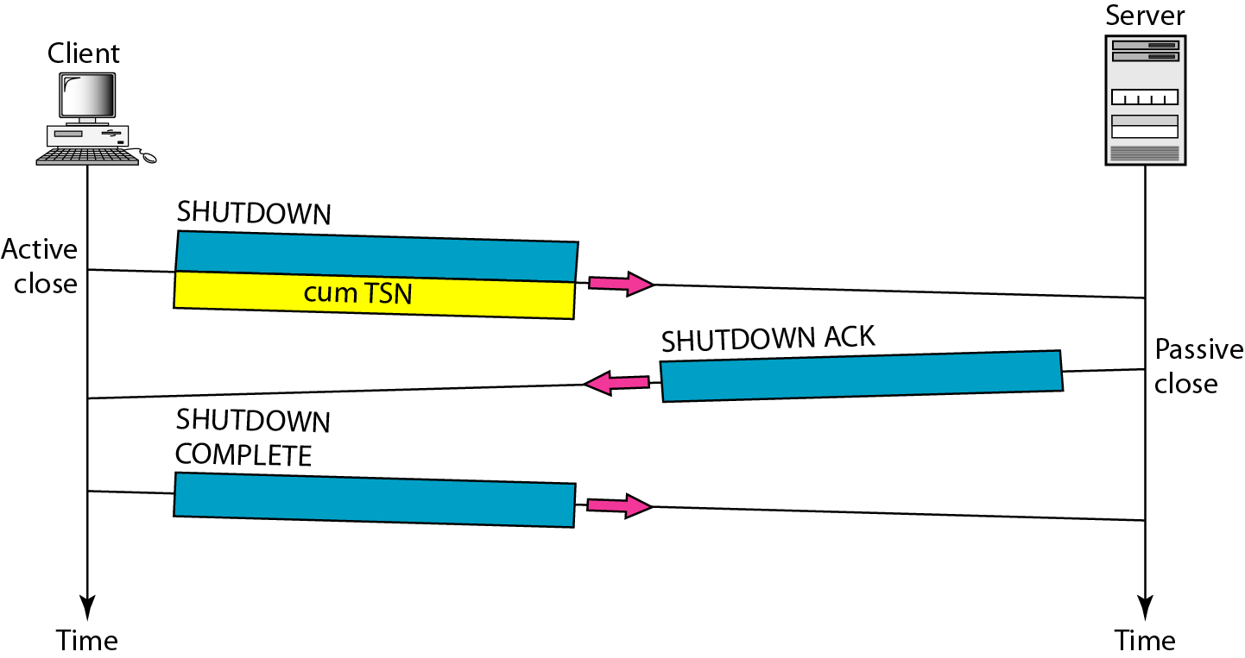
Association termination

Slide 84
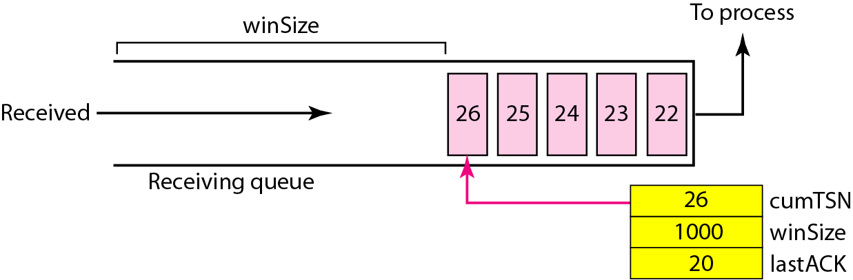
Flow control, receiver site

Slide 85
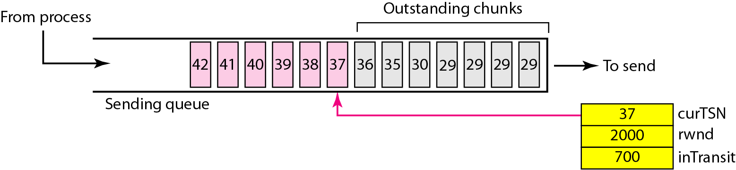
Flow control, sender site

Slide 86
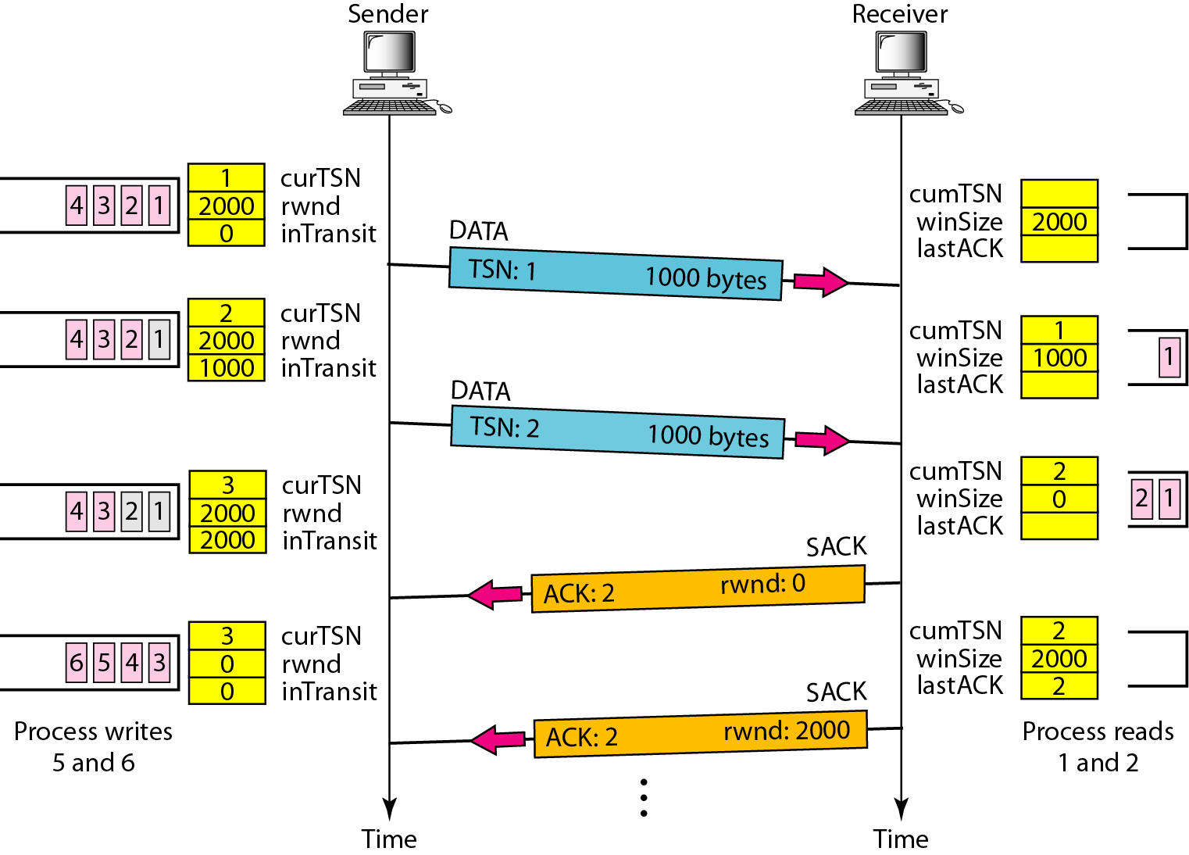
Flow control scenario

Slide 87
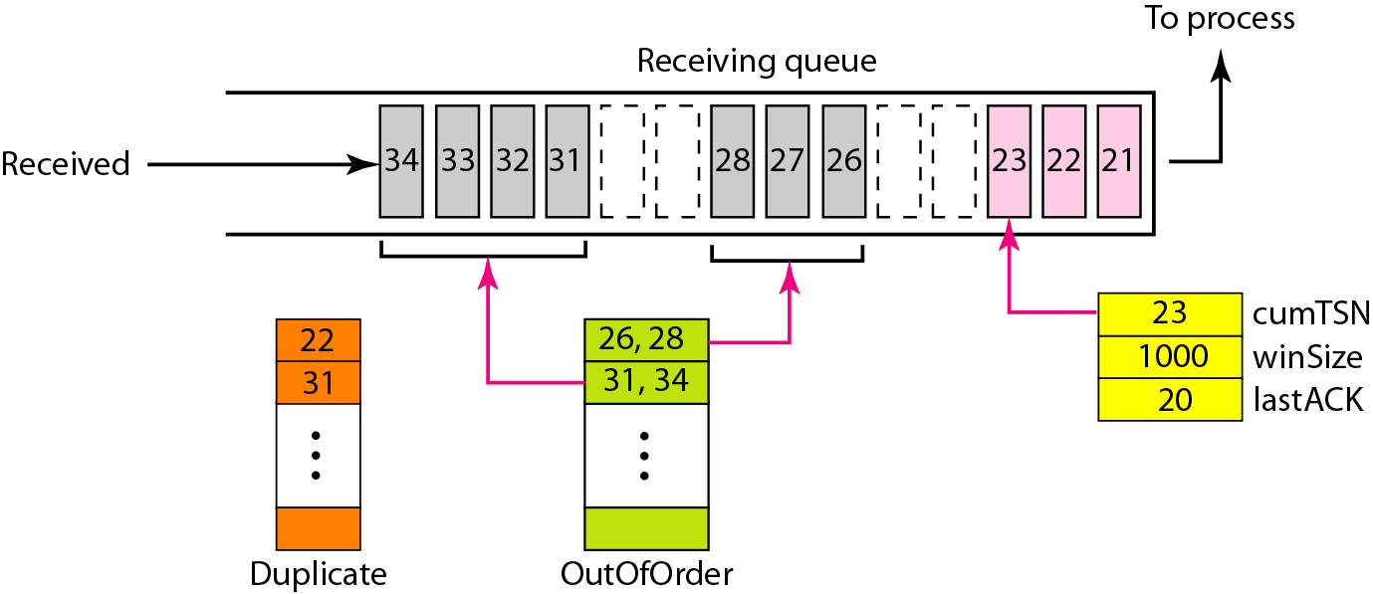
Error control, receiver site

Slide 88
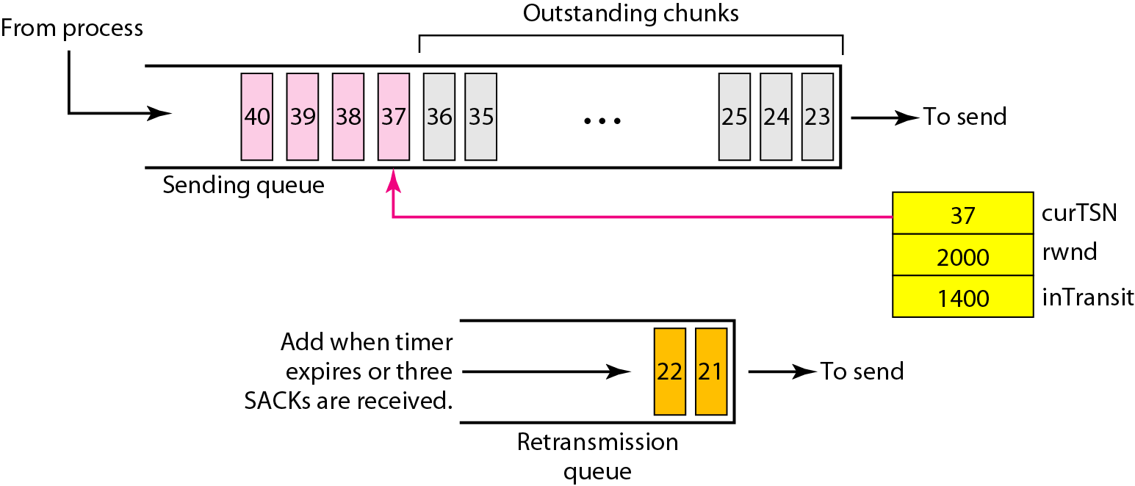
Error control, sender site

